Slide 1

WELCOME TO SPORTIFY
A SPORTS ACADEMIC MANAGEMENT SYSTEM

Slide 2
TEAM MEMBERS
ADITYAPRATAP SINGH (21103004)
AMIT KUMAWAT (21103011)
ABHAY MISHEA (21103001)
Fitness GYM

Slide 3
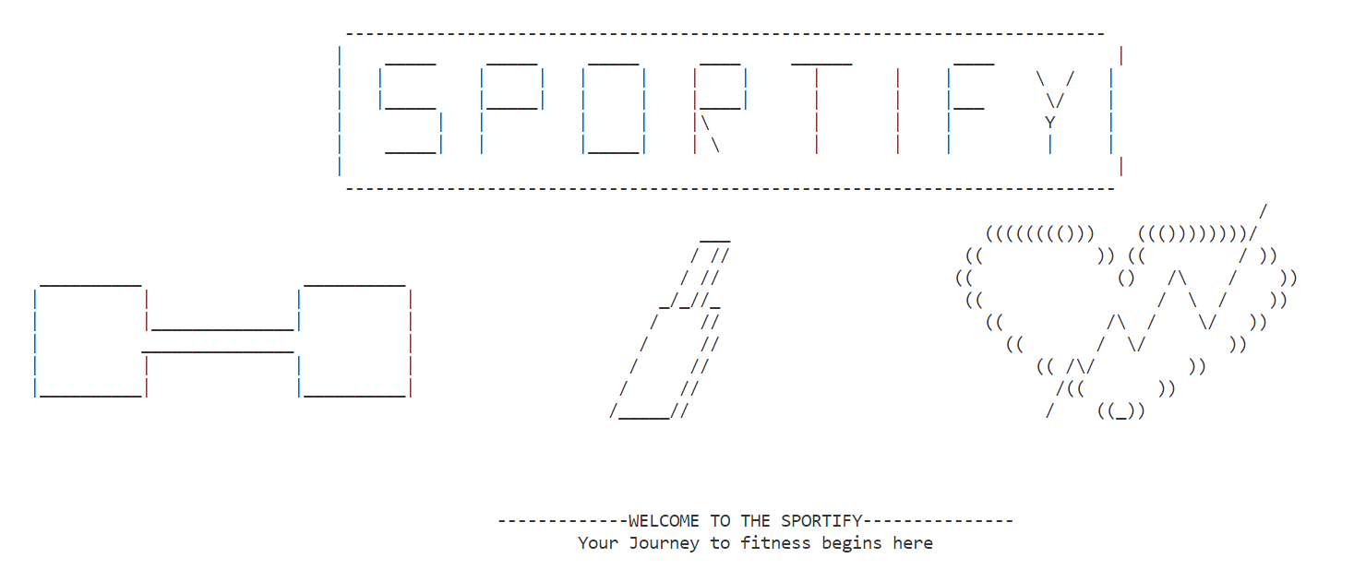
WELCOME PAGE OF OUR PROJECT

Slide 4
CONCEPT USED IN OUR PROJECT
ALL THE BASICS OF C++
POINTERS
STRUCTURES
DATA ABSTRACTION
DATA HIDING
ENCAPSULATION
INHERITANCE
FRIEND FUNCTION
FRIEND CLASS
STATIC MEMBER VARIABLE
OUTPUT FORMATTING
FILE HANDLING

Slide 5
Our USP
Hiring new employees.
Revneue generated.
Salaray given etc.
All data can be accessed and store.
Registration for new user.
Checking plans for different sports.
Healthify meter to check health status.

Slide 6
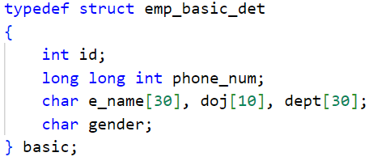
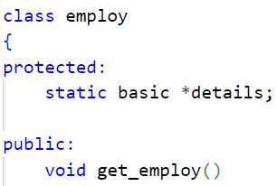
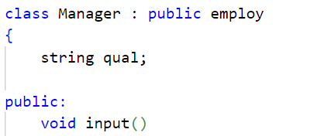
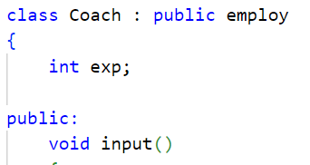
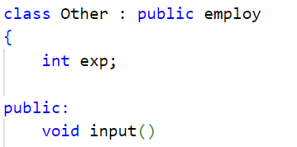
INHERITANCE

Slide 7
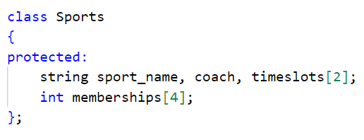
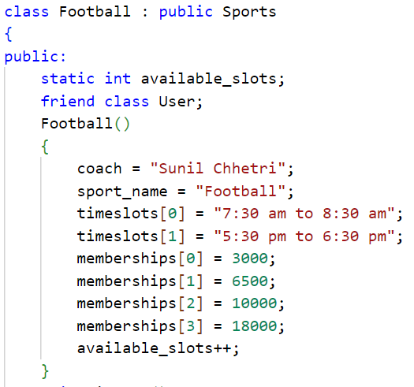
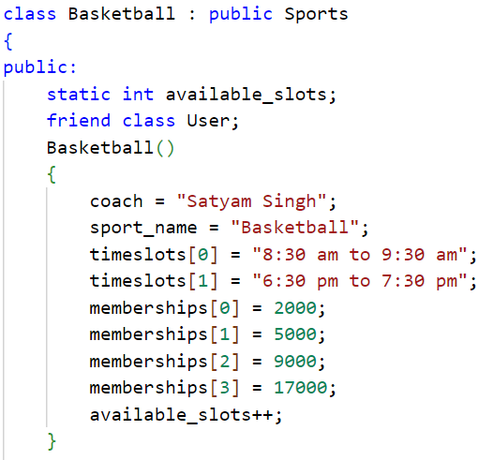
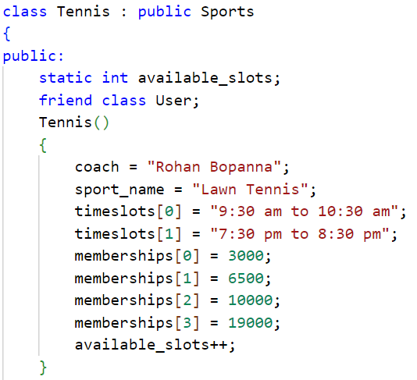
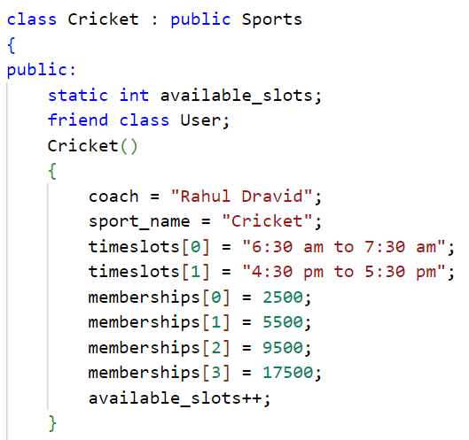
INHERITANCE(CONT..)

Slide 8
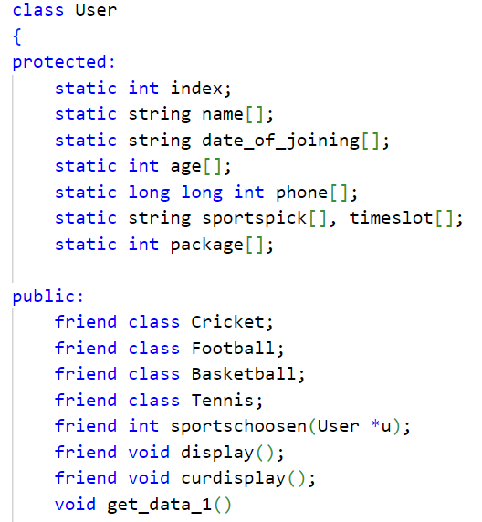
ANOTHER CLASS

Slide 9
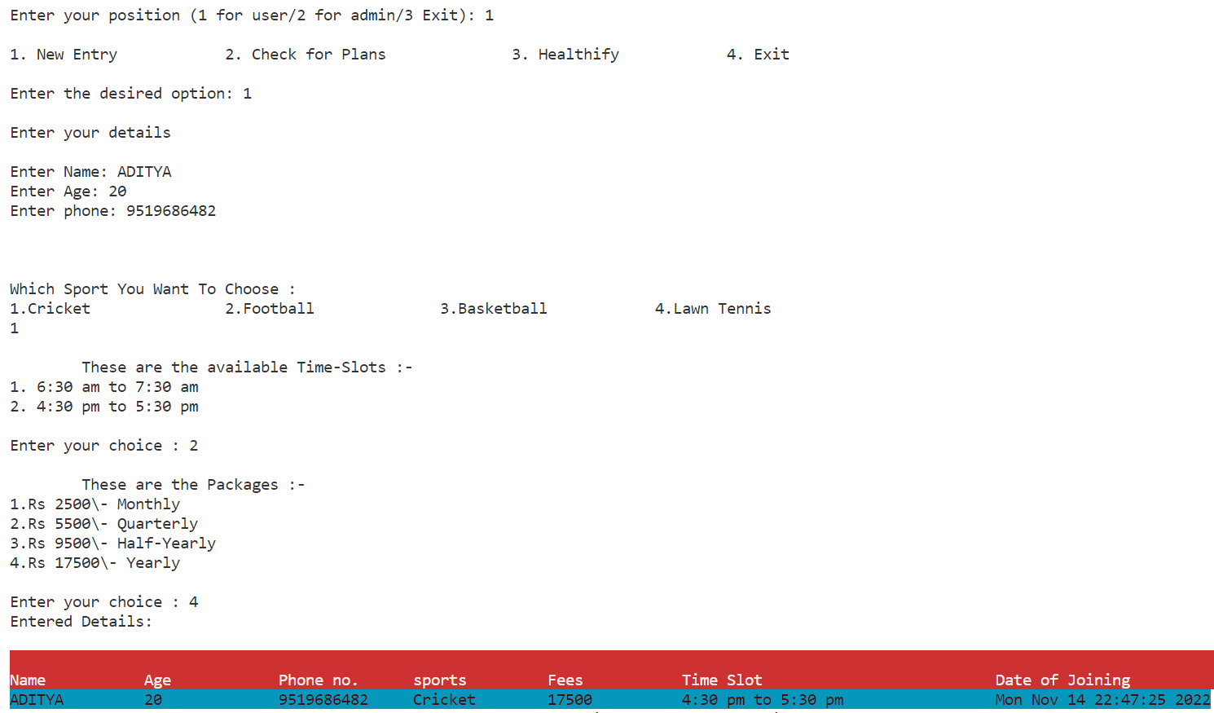
Some outputs from our code(user side)

Slide 10
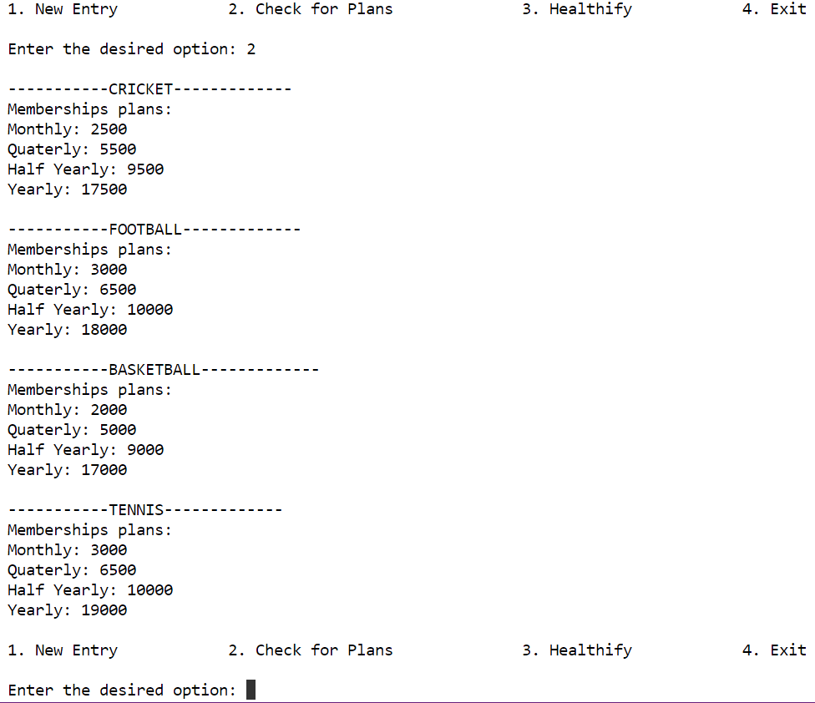
Some outputs from our code(user side)

Slide 11
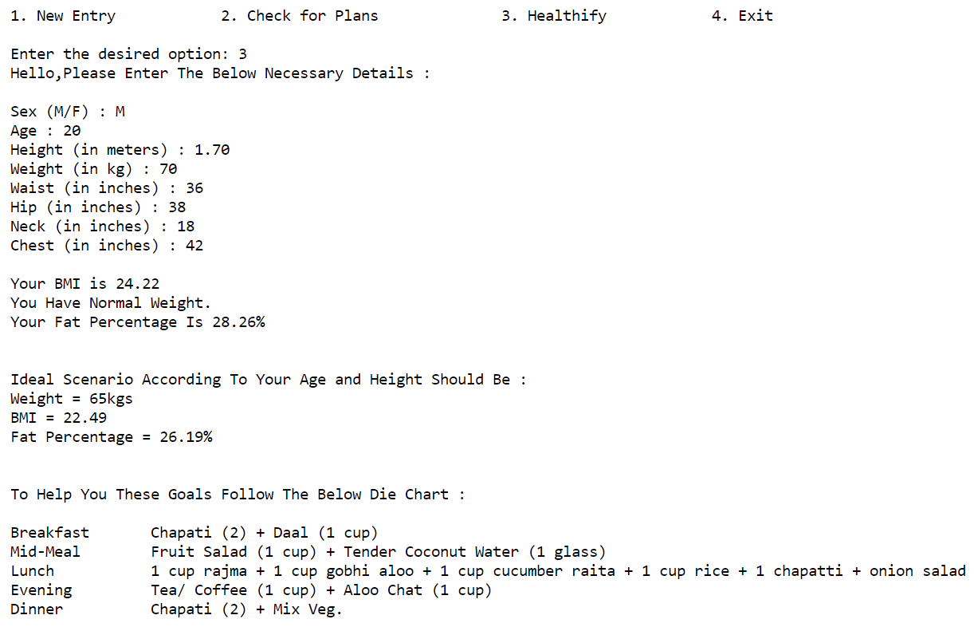
Some outputs from our code(user side)

Slide 12
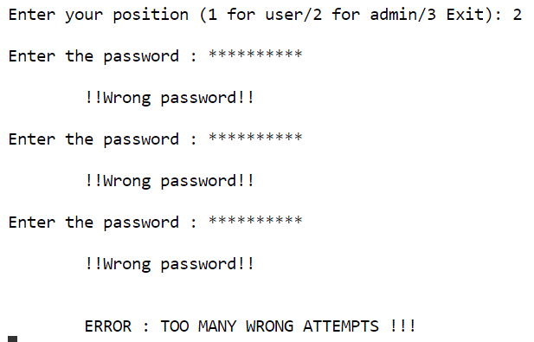
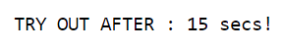
Some outputs from our code(admin side)

Slide 13
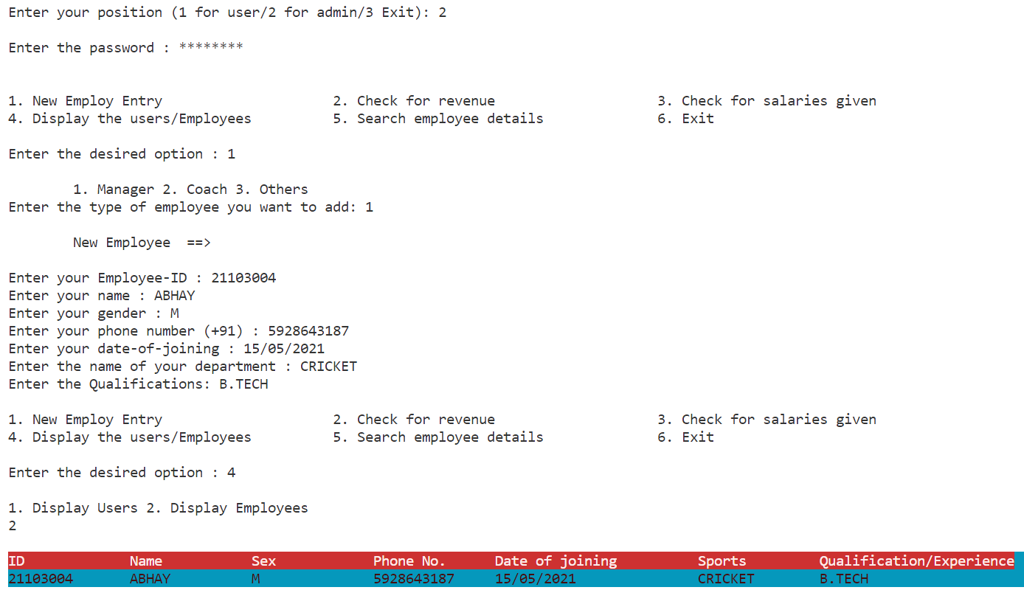
Some outputs from our code(admin side)

Slide 14
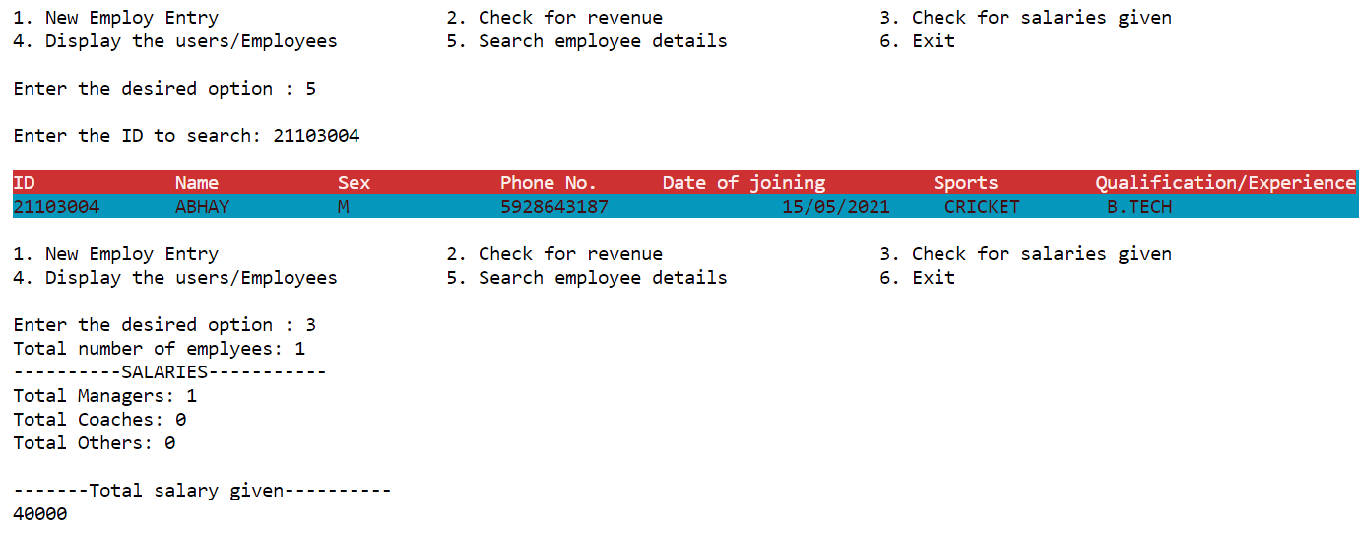
Some outputs from our code(admin side)

Slide 15
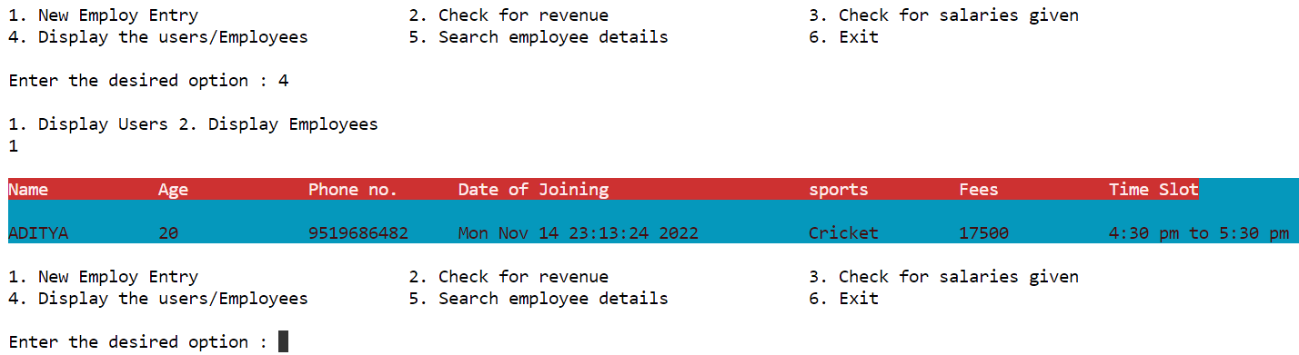
Some outputs from our code(admin side)

Slide 16
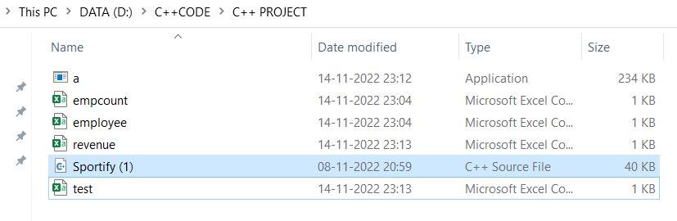
THESE ARE THE FILES WHERE WE STORE ALL THE DATA AND LETTER ON FETCH FROM THERE

Slide 17
HEALTHIFY
HEALTHIFY METER TO CHECK HEALTH STATUS

Slide 18
HOW IT CALCULATE YOUR HEALTH STATUS?
WHAT IS HEALTHIFY ?

Slide 19

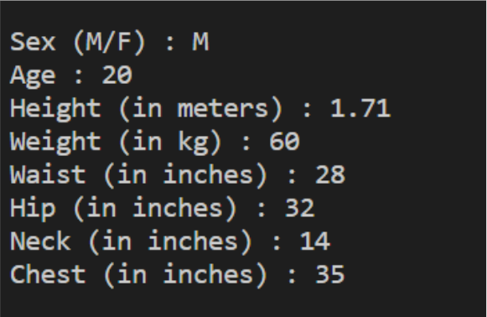
FIRSTLY IT WILL TAKE INFORMATION OF USER

Slide 20

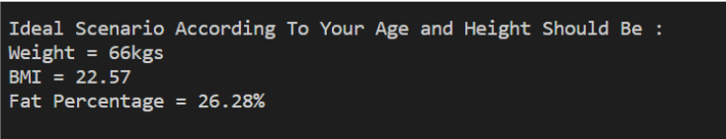
YOUR HEALTH STATUS

Slide 21

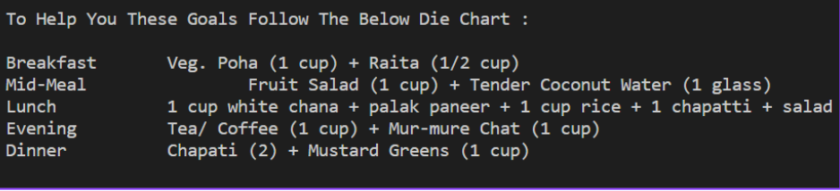

IT WILL ALSO HELP TO PLAN YOUR DIET

Slide 22


Slide 23


